Slide 1
Data Integration COMP90050 Advanced Database Systems
Presented by--
Group 5007
Xun Hu 724774
Hao Ma 777497
Yifeng Zhu 764991

Slide 2
Background information of data integration
What is data integration? Combining data residing in different data sources to provide a unified view of those data
Why is data integration so important? The key is saving a large amount of time to process data.
Three major steps:
1. Schema Alignment 2. Record Linkage 3. Data fusion
Xun Hu

Slide 3
Schema Alignment
What are the challenges with combination? 1. different number of tables for each data source 2. different attribute name to represent the same attribute 3. different semantic for the attribute with same name
What is Schema Alignment?
Process aim to align different schema
Three steps of Schema Alignment
1. Mediated Schema 2. Attribute matching 3. Schema mapping
Xun Hu

Slide 4
An example of database system
Xun Hu

Slide 5
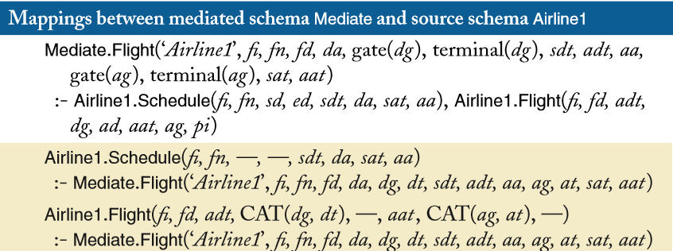
An example of Schema mapping
Xun Hu

Slide 6
Record Linkage
The second major step in traditional data integration
Aims to understand which records represent the same attribute
Definition:
Consider a set of data sources, each providing a set of records over a set of attributes. Record linkage computes a partitioning of the set of records, such that each partition identifies the records that refer to a distinct entity.
Yifeng Zhu

Slide 7
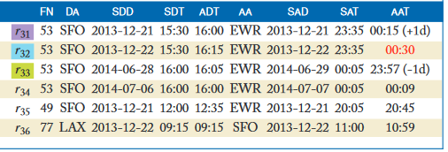
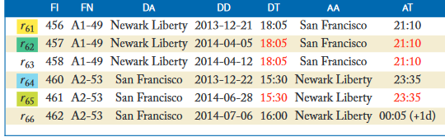
Record Linkage
Still challenging when schema alignment has been performed?
values in the attribute may differ due to mis-typing, multiple naming conventions, and so on
Example:
Yifeng Zhu

Slide 8
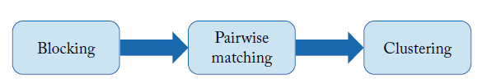
Record Linkage
three main steps: blocking, pairwise matching and clustering
Pairwise matching & clustering: ensure the semantics
Blocking: scalability
Yifeng Zhu

Slide 9
Pairwise matching
Pairwise matching is the basic step of record linkage
rule-based approaches
advantage: rule can be implemented to effectively deal with complex matching scenarios
disadvantage: requires considerable domain knowledge
classification-based approaches
advantage: do not require significant domain knowledge
disadvantage: requires a large number of training examples
Yifeng Zhu

Slide 10
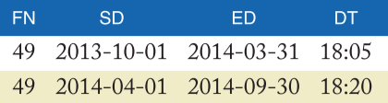
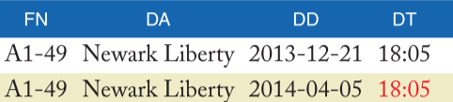
Data Fusion
What is Data Fusion
D → a set of data items, S → a set of data sources
s ∈ S, d ∈ D, find true value for d.
Why we need it
What is the goal
Airline1.Schedule
Airfare4.Flight
Hao Ma

Slide 11
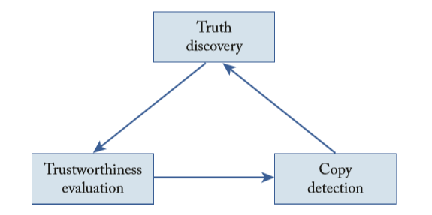
Approaches and challenges
Some early approaches to data fusion methods: taking average, maximum etc.
Challenges:
Veracity
Volume
Velocity
Variety
Architecture of data fusion to solve veracity challenge
Hao Ma

Slide 12
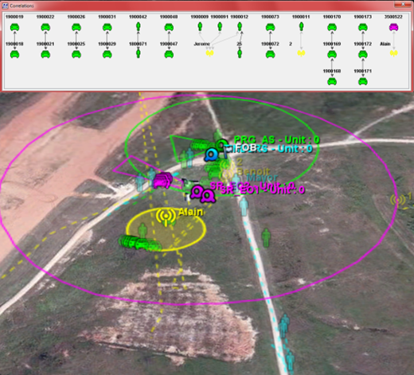
Application Areas
Geospatial Information Systems
Oceanography
Intelligent transport systems
Business performance management
Wireless sensor networks
For example:
Higher-level Data Fusion for Activity-based Intelligence -- Threat Detection Suite (TDS)
Hao Ma

Slide 13
Conclusion
Data integration involves combining data residing in different sources and providing users with a unified view of these data.
With data integration, we can save a large amount of time to process data and get the information we want
Three steps to achieve Data Integration
Schema Alignment
Record Linkage
Data Fusion
Challenges among the whole steps
Hao Ma

Slide 14
Questions
1. What are the issues of pipeline architecture when processing big data?
2. Inconsistency will rise if the pairwise matching declares that record pair R1 and R2 match, record pair R2 and R3 match, but record pair R1 and R3 do not match, what strategy can be used to address this issue?
3. Data fusion is categorized by corresponding to what?

Slide 15
Reference
Javlin . (2016). Dataintegrationinfo. Retrieved 19 May, 2016, from <http://www.dataintegration.info/>
Adrian mott. (2015). Why Data Integration is so important?. Retrieved 19 May, 2016, from <http://www.bedrockdata.com/blog/why-data-integration-is-important-how-to-justify-data-integration-to-c-level-executives>
METRON Scientific Solution. (2016). Higher-Level Data Fusion. Retrieved 19 May,2016,from <https://www.metsci.com/Division/ADA/Higher-Level-Data-Fusion>
Wikipedia. (2016). Data Fusion. Retrieved 19 May,2016,from <https://en.wikipedia.org/wiki/Data_fusion>
Dong, Xin Luna, 2015. Big Data Integration. 1st ed. Morgan & Claypool: Synthesis Lectures On Data Management.

Slide 16
Thank You!
Any Questions?

